Slide 1
Technology in Virtual Reality
By Sierra McCarthy

Slide 2
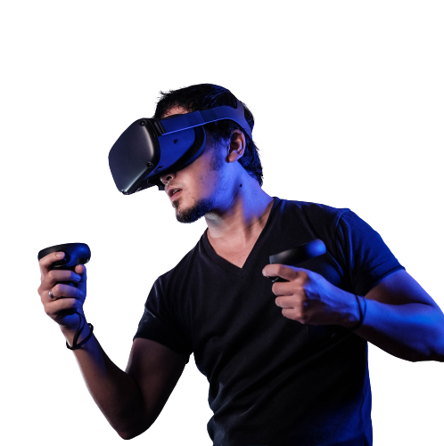
What is VR?
VR creates environments, experiences, and interaction that look and seem real but aren’t
A combination of hardware and software
By wearing a VR set, users are transported into a interactive world in which it can be explored and manipulated
This can make the user feel immersed in their surroundings

Slide 3
How does VR become immersive
The system consists of infrared LEDs, motion sensors, screens, and camera
Programmed to trick our natural stimuli and our responses
The system can create virtual objects that tricks the human brain

Slide 4
3 Types of Immersions

Slide 5
Non-immersive
No spatial computing features such as sensors
Only interact with the virtual environment on a fundamental level
Use controllers to interact
Ex. driving simulator which requires the user to sit behind a wheel and interact with pedals (does not typically involve a VR headset)

Slide 6
Semi-immersive
Described as a mixed reality
Does Not create an illusion of a different reality
Heightens your natural environment by adding digital objects on top of real objects
Common in education environments
Ex. flight engineers can use heads-up displays to see digital objects

Slide 7
Fully-immersive
Most frequently used VR
Provides a 360-degree simulated environment
The world around the user completely disappears and is replaced with images and sounds
Headsets use AI and motion sensors to move you through the alternate reality

Slide 8
The Components of VR

Slide 9
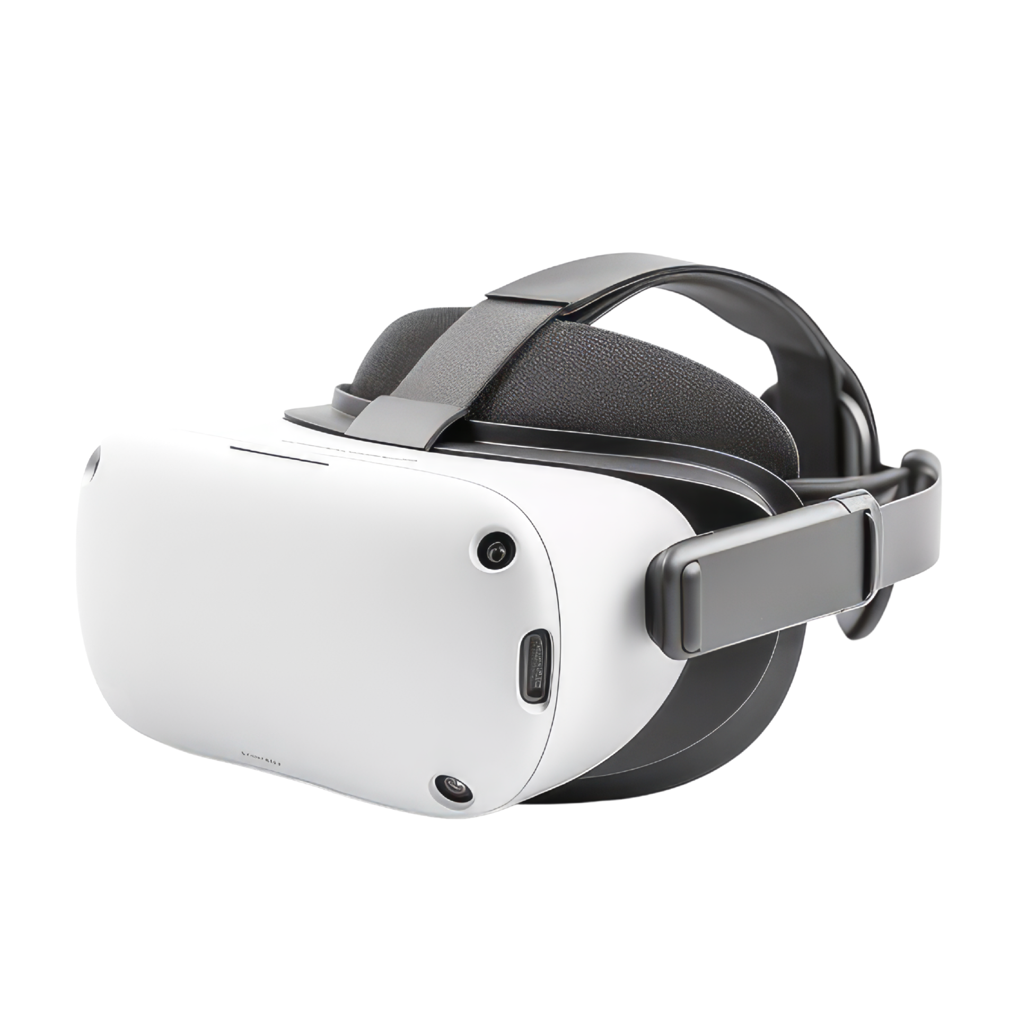
VR Headsets
Head-mounted wearable device which replaces the users natural field of vision with a computer generated alternative

Slide 10
Lenses and Screens
Includes stereoscopic lenses which is positioned between a screen and the eyes to distort the image and make it three-dimensional
Passes two images through each eye
Trackers allow the device to shift between different images as the user moves their head

Slide 11
Latency and Field of View
Aligns the virtual reality information within the headset with the real world
Generates a 3-D environment
The average human sees the world around them in a 200 to 220-degree arc around their heads
Vision from their left and right eyes overlap at an angle, causes them to see in three dimension
Minimal latency is essential for the user to see change simultaneously when moving their heads

Slide 12
Frame Rate
Can regulate how immersive the experience can be
Can cause VR sickness if not created properly
The human eye can see up to 1,000 FPS, while the brain can only interpret frame rates up to 150 FPS
VR creators found that if the rate is less than 60 FPS it can cause nausea and headaches
Many developers aim to have 90 FPS to make it a smooth experience

Slide 13
Spatial Audio
Popular due to realistic components
Many audio innovators have used this type of 3D audio such as spotify and youtube
User can hear sounds coming from different areas such as behind, above, or below
Sound and where it comes from influences our perception of a three-dimensional space
Position sound around the users head

Slide 14
Movement and Position Tracking
The user can move around and interact with their environment
Position-tracking tech. uses a combination of sensors, gyroscopes, and AI to control with the user sees while moving around
Basic headsets initially used three degrees of freedom systems, this only allows the user to look left, right, and up and down
Advanced headsets use six degrees of freedom to have a 360-degree format

Slide 15
VR Controllers
Consists of buttons, thumbsticks, and sensors that tracks users hand movements
Hardware components that allows the users to take action and do things in a virtual environment
Controllers allow us to submit information about what action the user wants to do in the VR software directly
Developers are experimenting with spatial computing tech. like trackers and sensors to minimize the need for controllers

Slide 16
The Evolution of VR

Slide 17
Timeline of VR
1935
1962
1960
1961
1965
Science fiction writer Stanley Weinbaum created a fiction story called “Pygmalion Spectacles”
Cinematographer Morton Heilig created “Sensorama”, first VR experience. Was a booth like structure. Consisted of multiple technologies such as 3D video, vibrations, smells, and gust of wind
Morton Heilig invented “Telesphere Mask”. First headset. No sensory tracking; was 3D images with wide vision
Corporation engineers Comeau and Bryan invented “Headsight”. First motion tracking HMD. each eye had its own built in video screen and a head tracking system
Ivan Sutherland, a computer sciented, presented his vision of the “Ultimate Display”. Him releasing this article deemed him the fundamental blueprint of VR

Slide 18
HERE GOES YOUR TIMELINE.
1968
1975
1982
1985
1991
Sutherland and Bob Sproull created the first VR HMB named “The Sword of Damocles”. Head mount connected to a computer rather than a camera
Myron Krueger, a computer artist created “videoplace”, first interactive VR platform. Consisted of dark rooms with large video screens. computer -generated silhouettes imitating their own movements and actions
Sayre gloves were created by Sandin and Defanti. First wired gloves. Monitored gand movements by using light emitters and photocells
Jaron Lanier and Thomas Zimmerman found VPL Research Inc. first company to sell VR goggles and gloves
Antonio Medina, NASA scientist, designed VR system to drive the Mars robot from earth

Slide 19
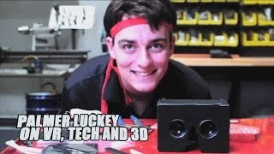
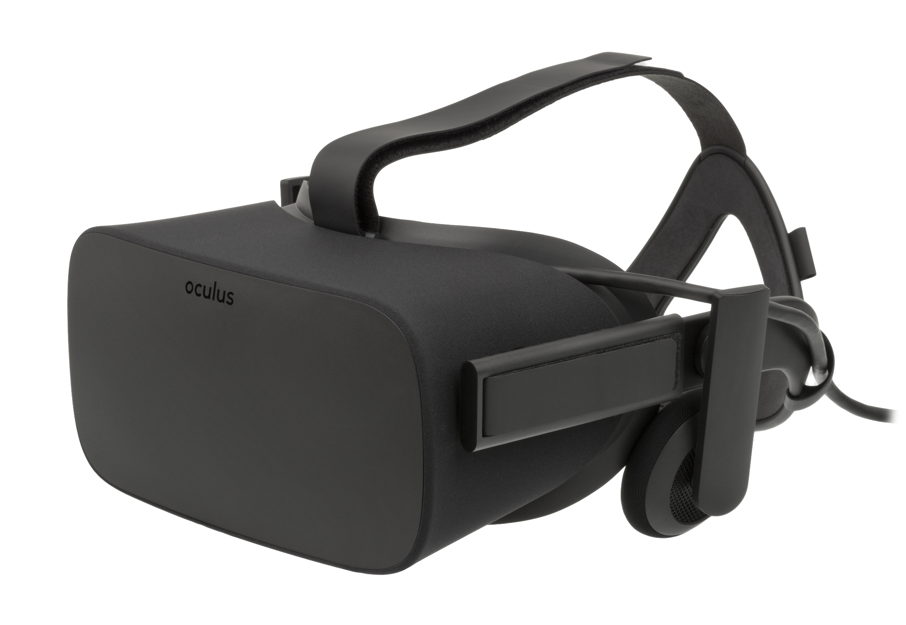
Oculus
Palmer Luckey created the prototype of the Oculus Rift Headset in 2010
Featured 90-degree field of vision which was unseen by the consumer marker at the time
Relied on a computer processing power to deliver images
In 2012 there was a campaign for the Oculus Rift which raised $2.4 million dollars
In 2014 Facebook bought the Oculus VR company for $2 billion

Slide 20
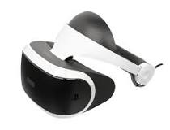
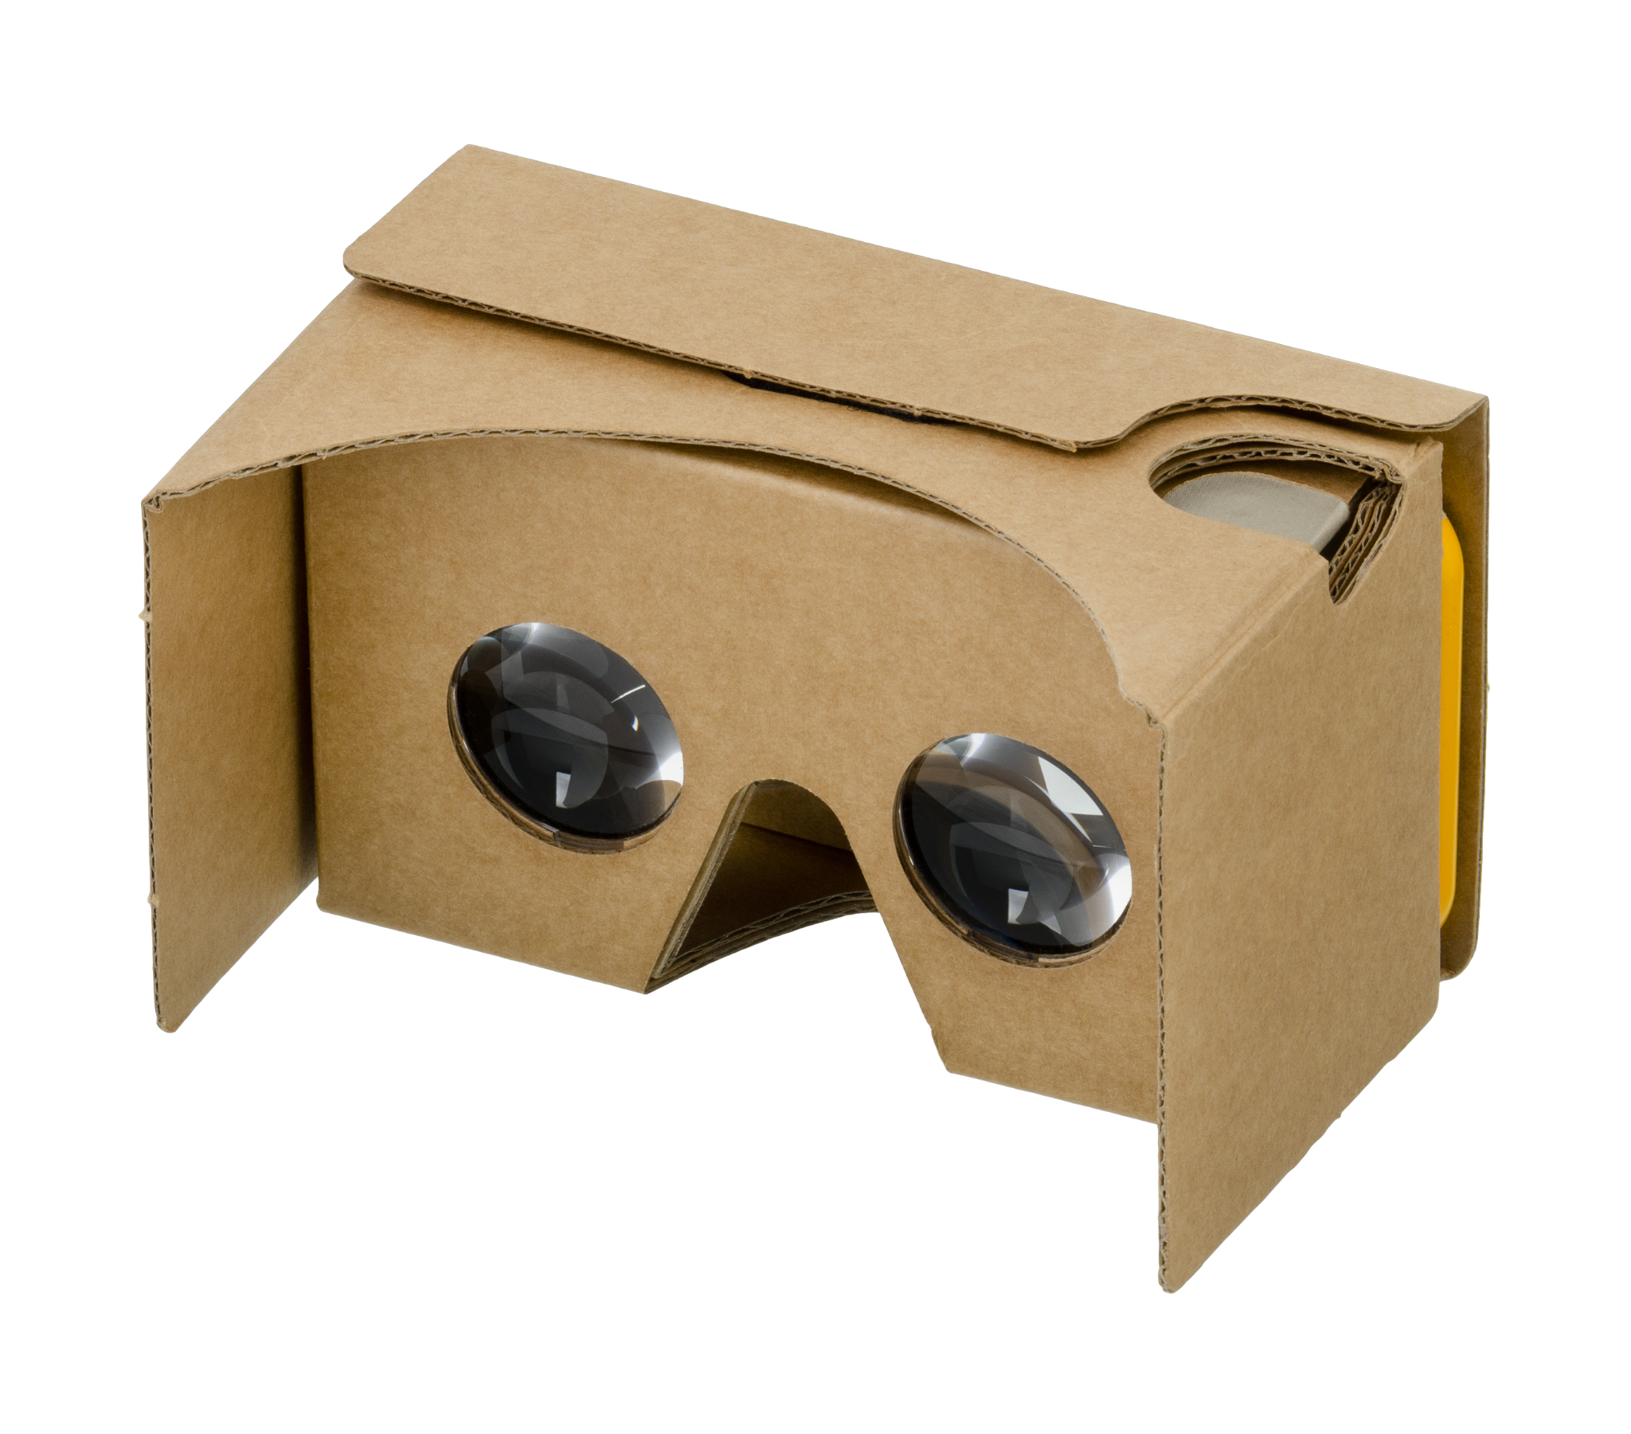
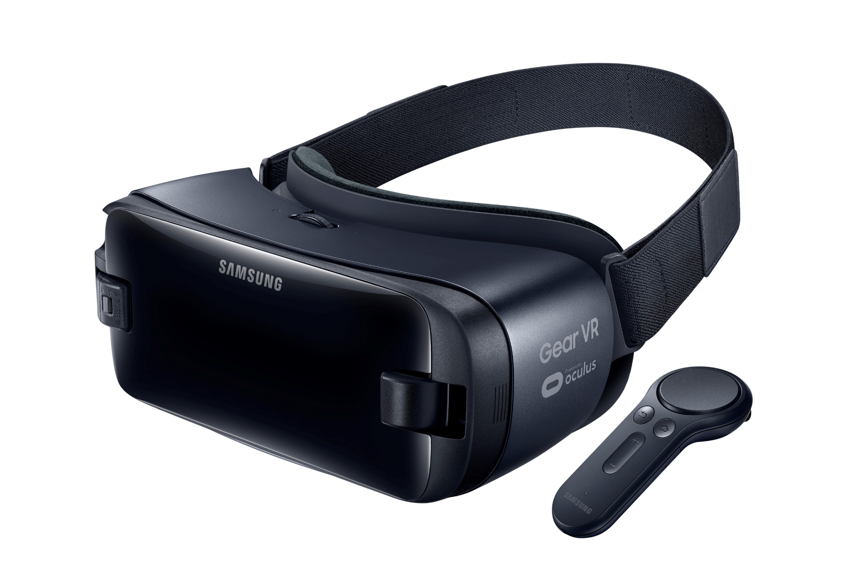
2014 releases
Sony announced that they were working on Project Morpheus which was a VR headset for the PS4
Google released the cardboard which was a low cost stereoscopic viewer for smartphones
Samsung announced the Samsung Gear VR which is a headset that uses Samsung Galaxy smartphones as a viewer

Slide 21
2015 releases
The BBC created a 360-degree video where users view a Syrian migrant Camp
The Washington Post released a VR experience of the Oval Office at the White House Correspondents Association Dinner
RYOT created a short VR film about solitary confinement in US Prisons

Slide 22
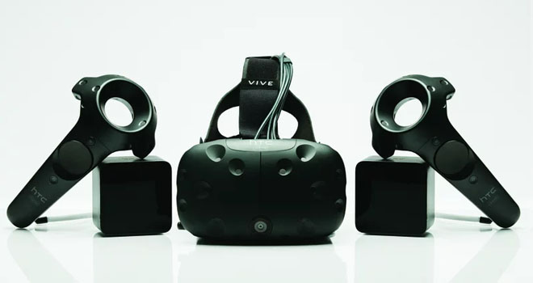
2016
Most headsets had dynamic binaural audio
Haptic interfaces were underdeveloped
Headsets were typically button operated
HTC released its HTC VIVE SteamVR Headset which was the first commercial release of a headset with sensor-based tracking

Slide 23
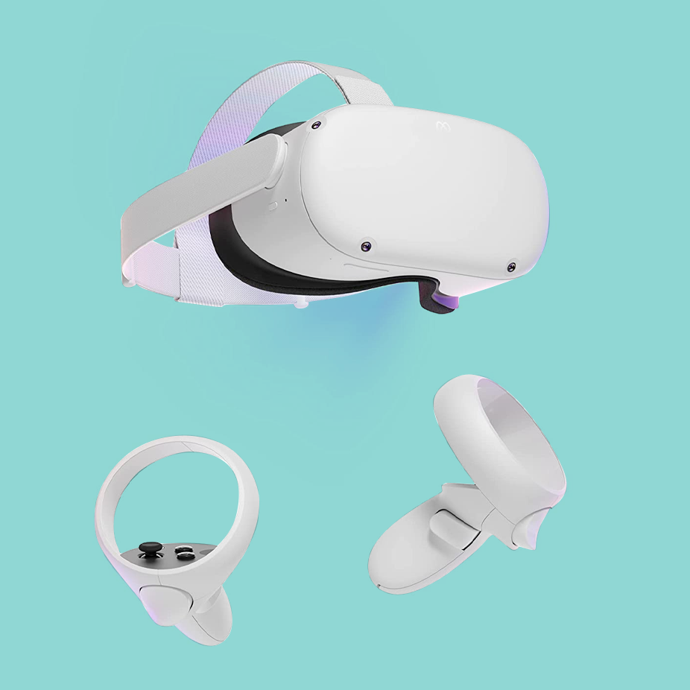
2020
The Oculus Quest 2 was released on September 16, 2020
Much-improved chipset
Works with snapdragon XR2 system which allows better and more comprehensive games
A significant improvement over the old system of the Oculus 1

Slide 24
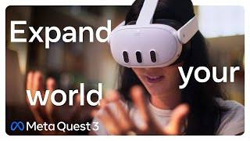
2021
2023
Pico launches the Pico Neo 3 headset which was a computer to the oculus quest 2 headset
Facebook (Meta) plans to spend at least $10 billion this year on facebook reality labs, creating AR and VR hardware, software, and content
Apple announced the Apple Vision Pro
Sell for $3.499
Meta announced Meta Quest 3
Meta quest 3 is a mixed reality headset featuring significant advancements in display quality, power, tracking capabilities, and processing
Boast a resolution of 2160x2160 per eye
Headset is available for $499

Slide 25
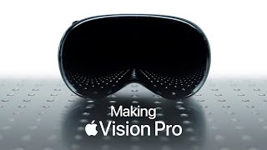
2024
Apple Vision Pro was released on february 2nd to early adopters in the U.S
The release caused some excitement while some raised concerns about its accessibility and content ecosystem

Slide 26
THANK YOU!

